Slide 1
Lab 14
Digital Combination Lock with Pseudo-Random Combination
Source: Purdue’s notes

Slide 2
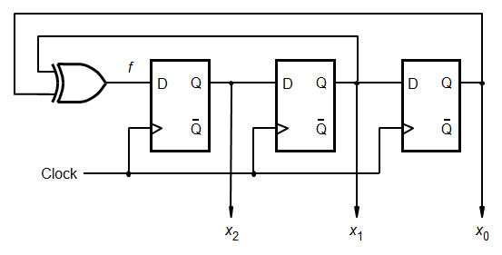
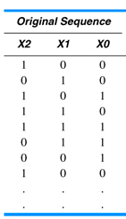
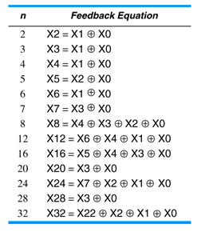
LINEAR FEEDBACK SHIFT-REGISTER (LFSR)

Slide 3
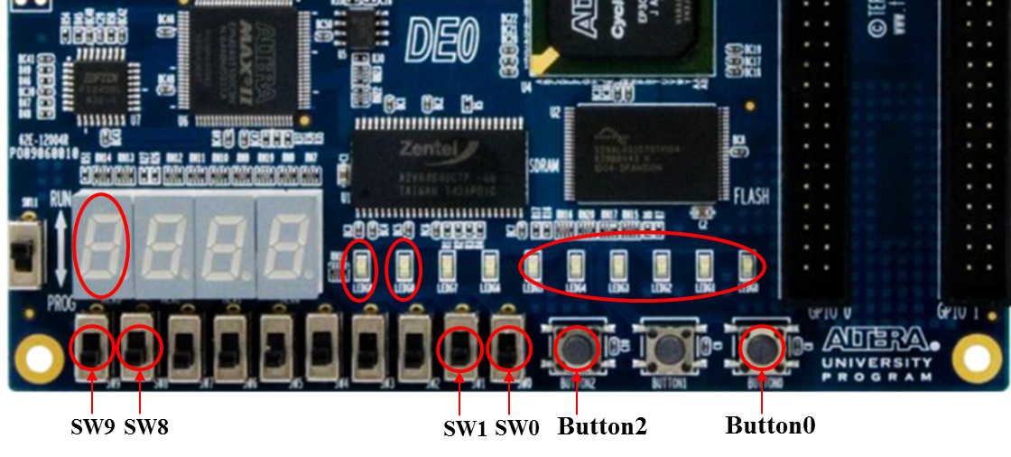
EXPERIMENT STEP (1):
Create a 6-bit linear feedback shift-register (LFSR) that generates a pseudo-random sequence
Use SW0 to enable/disable the random sequence generation (when disabled, the current state should be retained).
Route the outputs of the LFSR to the LEDG5~0, and use SW1 to control whether the LFSR outputs are “hidden” or displayed.
Use Button0 to asynchronously set (not reset) the flip-flops that comprise the LFSR portion of the circuit, i.e., “100000”.
Use 1Hz clock as the clocking source for this LFSR.

Slide 4
EXPERIMENT STEP (2):
Part1: Design a digital combination lock (DCL).
Create a 3-bit counter and route its outputs to HEX3.
Use Button2 to clock the counter, and use Button0 to asynchronously reset the counter.
With reference to the digital combination lock design in “module3c”, draw a state transition diagram that specifies the behavior of the sequence recognizer portion of DCL using a Moore model. Note that the 6-bit binary combination to be recognized is “unknown” (i.e., will be based on “matching” the randomly-generated digits from LFSR.)
Button2 is also used to clock the sequence recognizer.
Use SW9 to successively enter the data bits of DCL. Note that the data bit entered has to “match” the corresponding bit of the pseudo-random combination generated by the LFSR in order to advance toward the “Unlock” state.
Meanwhile, HEX3 “indicates” the bit of the combination that is currently in play, i.e., HEX3 = ‘0’ indicates the current setting of SW9 is for the x₀ digit of DCL.

Slide 5
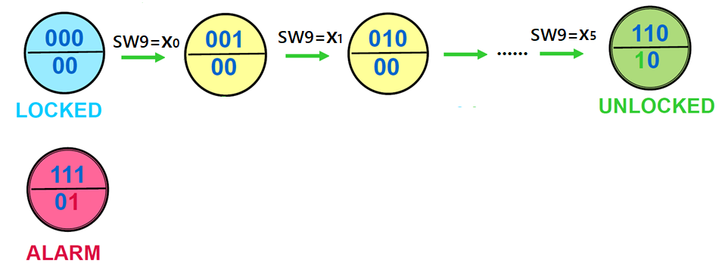
EXPERIMENT STEP (2):
Part1: Design a digital combination lock (DCL).
If all six digits of the combination are successfully entered, LEDG9 should be illuminated signifying the “Unlock” state. Once the unlock state is reached, the sequence recognizer should ignore any further data entry from SW9 until the “relock” input (SW8) is asserted, at which time clocking in either a “0” or “1” data bit will return the state machine to the initial locked state.
If, however, a “mistake” is made at any point during entry of the combination it goes into the “alarm” state, and LEDG8 should begin to flash at 1 Hz rate to signify an “alarm” condition.
Note that an asynchronous reset (Button0) is the only means by which the sequence recognizer can be reset once the alarm state is reached.

Slide 6
EXPERIMENT STEP (3):
Part2: Design a digital combination lock (DCL).
Continue the DCL developed in Step(2), create a state machine that generates the following character sequences to scroll across four 7-segment displays:
“OPEn” (when the sequence recognizer reaches the “Unlock” state)
“Err-” (when the sequence recognizer reaches the “alarm” state).
Scroll from left to right at 1 Hz rate.

